Slide 1
Experimental Economics Lecture 3
Third presentation to the Doctoral Students, University of Bari
John Hey
October 2023

Slide 2
Calibration
Running a pilot experiment
Checking the software
Choosing treatments
Choosing parameters
Choosing problems
Writing Instructions

Slide 3
A pilot experiment
This describes a small trial of the experiment with the chosen parameters and problems.
It will give you some idea of the likely magnitude of the noise in your data. (See Lecture 5).
It will help you choose a good set (and number) of problems.
It will help you check your software.

Slide 4
Treatments
I have not talked about treatments before, but treatments are crucial to the whole idea of control.
Remember that experimental economics is about the investigation of economic theories under controlled conditions (all things irrelevant to the theory are kept constant).
Treatments are where the underlying parameters are fixed.
Usually, different sessions have different treatments, but sometimes one may want two treatments in one session. (The difference is whether the analysis is to be within-subjects or between-subjects).
If you decide to have several treatments in one session, you will need to decide the order of the treatments.

Slide 5
Calibrating the experiment
This is probably the most important part of the design.
You need to understand the theory you are examining.
You need to calibrate the software so that it shows everything that the subjects need to see, and will work for the parameters you want to use.
You need to check the questions that you are going to ask the subjects and check that the software will accept any answers that are reasonable.
You need to select values for the parameters you want to use.
You need to choose the problems you are going to propose to your subjects.
Separate the parameters that you want to leave fixed throughout the experiment/treatment from those that you will want to change.

Slide 6
Choosing the problems, the number of them, and the number of subjects
The subject’s decision on each problem is one data point/one observation.
Let n denote the number of problems you give each subject and m the number of subjects.
If you are going to do your data analysis across subjects then mn is the number of observations that you will have.
If you are going to do your data analysis subject by subject then n is the number of observations per subject that you will have.
I recommend that you anticipate (whether you have enough observations) by running extensive simulations on your proposed problem set before you run your experiment.

Slide 7
Pre-experiment simulations
You should simulate some possible decisions from your experiment before you run it.
Take your problem set and your assumed stochastic specification (as discussed in Lecture 5) and randomly simulate several sets of responses with given parameters.
For each set, estimate the parameters of your model (as discussed in Lecture 5). Use the several sets to see if you get significance where you should, and non-significance where you should not.
Clearly this will depend (mainly) on the magnitude of the noise (the variance of the stochastic term – see Lecture 5), but also on the other parameters and upon the problem set.
Keep on trying problem sets until you get significance where you should.
(This will work unless your noise assumption is wrong. You should try a pilot experiment to get some idea of the magnitude of the noise.)

Slide 8
Instructions
These are crucial.
These need to be carefully written and checked by an ‘outsider’.
It is important that the subjects understand them completely.
You might give them written instructions (which are read out loud by an experimenter).
You might prepare a Panopto presentation on all subjects’ screens or on a large screen that all can see.
You might include some test questions in the experimental software that they have to answer correctly before proceeding to the experiment.

Slide 9
Incentives
Central to Experiments in Economics are incentives.
Most economic journals will not consider for publication an experiment without incentives.
This is in stark contrast to psychology journals which are much more lax on incentives.
Almost always the incentive is money. (Some psychologists use exam marks – we consider that to be unethical.
You should make it abundantly clear from the start how they will be paid.
You should relate their payment to the outcome of their decisions (in line with the theory you are investigating).

Slide 10
Payments
If you are giving them a set of problems, and there is a payoff on each…
…are you going to pay them on all problems?
… or on a randomly chosen one?
Are you going to pay all subjects?
… or a randomly chosen one/subset?
If, during the experiment, the payoffs are denominated in ECUs (Experimental Currency Units) you will need to decide the exchange rate between ECUs and money.
Make sure that the exchange rate is such that you do not exhaust your budget.

Slide 11
An example of good calibration
This is from an experiment by Buso and Hey on Search and Switch. You can find the paper on the site.
Subjects were asked to imagine that they were buying something (for example, gas and electricity) from their ‘local’ supplier and were searching for something better. There is a search cost for each non-local supplier and a switch cost if the subject decided to switch to a non-local supplier.
Key parameters: search cost c, switch cost s, the number and distribution of non-local offers.
We decided to have two treatments (to test the robustness of our results) with different values for the number and distribution of non-local offers.
We chose a set of c and s values to test the comparative static propositions from the theory.

Slide 12
Comparative Statics 1
An increase in the search cost c:
increases the likelihood that the initial offer is accepted, (and hence) decreases the likelihood that a consumer starts search beyond her local firm, and decreases the likelihood of continuing search at any stage
it also has a stronger impact on the choice of starting search than an increase in the switching cost s.
does not affect the likelihood that a consumer switches to a non-local firm, once the consumer stops searching.

Slide 13
Comparative Statics 2
An increase in the switching cost s:
increases the likelihood that the initial offer is accepted, (and hence) decreases the likelihood that a consumer starts search beyond her local firm
does not affect the number of non-local searches and the minimum offer necessary to stop search, given that the consumer started to search
reduces the likelihood that a consumer switches to a non-local firm, once the consumer stops searching.

Slide 14
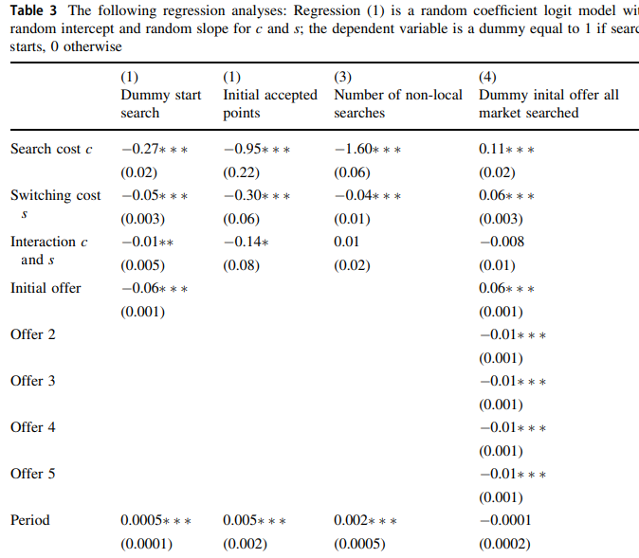
Regression results

Slide 15
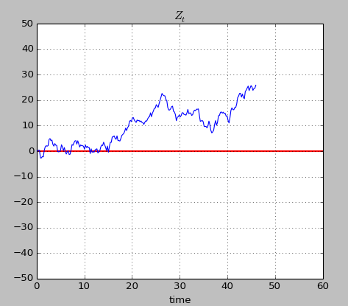
An example of bad calibration Taken from an experiment of mine with Konstantinos Georgalos and Martin Forster
This was investigating a theory paper by Epstein and Ji, “Optimal Learning Under Robustness and Time-Consistency” in Operations Research 2020.
It involves a decision problem in which the DM can bet on a colour from a two-colour – Red and Blue - each equally likely) risky urn or on a colour from a two-colour ambiguous urn, and can observe a costly noisy signal which gives information about the ambiguous urn.
The information is in the form of Brownian Motion with a positive (negative) drift if Red (Blue) is more likely than Blue.
In this picture, the information starts out confusing but then it becomes clear.
There is a cost for observing the information.
The key question is “how long should the DM observe?”

Slide 16
Theory
The theory (under the assumption of a Maximiner) says that the optimal strategy of the DM is to keep on observing until the motion crosses a threshold, which depends upon:
The drift of the motion
The standard deviation of the motion
The attitude towards ambiguity of the DM.
The cost of observing
This assumes that the DM starts observing. It is optimal not to if:
The cost is too high
The drift is too low
The standard deviation is too high
The DM is too averse to ambiguity.
Our intention was to test the theory and to estimate ambiguity aversion.

Slide 17
What we did wrong
The parameters we chose were bad in the sense that subjects should stop observing very soon, or, worse, never start observing. In particular, the cost of observing was too high.
We were hoping to estimate their ambiguity aversion, but failed.
So we wasted a lot of time and money.

Slide 18
The task for today
I want you to smell* one of these two papers in teams and tell me what it was trying to do and whether it succeeded.
“Labor Supply Reaction to Wage Cuts and Tax Increases: A Real-Effort Experiment” Mori, Kurokawa and Ohtake, NEP Experimental Economics.
This an individual experiment.
“Selection into Leadership and Dishonest Behavior of Leaders: A Gender Experiment” Grosh, Muller, Rau and Zhurakhovska, NEP Experimental Economics.
This is a group experiment.
* ‘smelling means reading superficially; the abstract; the conclusions; perhaps some experimental detail. Smelling is an important thing to learn.

Slide 19
Address the following points Some of which you won’t be able to address until later in the course
What was the point of the experiment?
Was the experimental implementation appropriate?
Was the data analysis appropriate?
Were there enough subjects?
Were there enough tasks?
Was the paper structured and written well?
I asked you to give your report in this lecture.

Slide 20
A Task for the next lecture
I would like you to look at the paper by Epstein and Ji, a copy of which you can find on the course website.
This is a difficult paper to read and it is full of dense mathematics.
It is about decision-making under ambiguity.
It contains comparative static propositions [and also a precise optimal strategy for a DM with a particular preference functional (the maxmin model of ambiguity-averse preferences)].
Much of the paper is dense mathematics, but there are clear results:
[The solution for a maxmin DM is specified on the right-hand side of page 7 (equations 21 to 24)].
The comparative static propositions are
“Sampling time increases when (1) Cost c falls; (2) σ and α increase in such a way that α/σ² is constant”
(α is the drift in the Brownian Motion and σ is its dispersion; c is the cost of sampling)

Slide 21
A Task for the next lecture (continued)
I would like you to design a simple experiment which focusses on the Comparative Static propositions of the paper.
The comparative static propositions are
“Sampling time increases when (1) Cost c falls; (2) σ and α increase in such a way that α/σ² is constant”
(α is the drift in the Brownian Motion and σ is its dispersion; c is the cost of sampling)
[Do not worry, at this stage about fitting the model and seeing if it fits better than other models.]
Describe the problem that subjects will be asked to tackle, and how they will be rewarded.
Pay particular attention to the number of treatments you will use, and the values of the key parameters* in the various treatments.
Describe how you would analyse the data.
*(α and σ, the drift and spread of the Brownian Motion; and c, the sampling cost.)

Slide 22
That is the end of Lecture 3.
As ever, I am happy to answer any questions.
john.hey@york.ac.uk

